Slide 1
Task-oriented interactions in Microsoft Teams with messaging extensions
Notes:
Messaging extension search commands allow your users to search external systems and insert the results of that search into a message in the form of a card.

Slide 2

Overview
Search commands
Creating search commands
Notes:
In this unit, you’ll learn how to execute a messaging extension search command from an existing message.

Slide 3
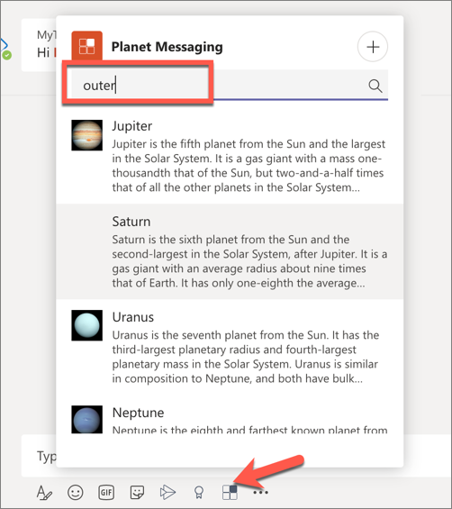
What are search commands?
Action commands enable users to search an external system for information
Search query is sent from Microsoft Teams to your web service
Your web service responds with a list or grid of results
When a user selects a result, it is added to the compose message box as a card or text
Notes:
Search commands allow your users to search an external system for information (*either manually through a search box, or by pasting a link to a monitored domain into the compose message area*), then insert the results of the search into a message.
In the most basic search command flow, the initial invoke message will include the search string the user submitted. You'll respond with a list of cards and card previews. The Microsoft Teams client will render the card previews in a list for the end user to select from. When the user selects a card, the full-size card will be inserted into the compose message area.

Slide 4
Register search command messaging extensions in the app manifest
"composeExtensions": [
{
"botId": "<REPLACE_WITH_MICROSOFT_APP_ID>",
"canUpdateConfiguration": false,
"commands": [
{
"id": "planetExpanderSearch",
"type": ”search",
"title": "Planet Lookup",
"description": ”Search for a planet.",
"context": [ "compose"],
"parameters": [{ title: “Planet”, name: ”searchKeyword”,
description: ”Enter ‘inner’, ‘outer’, or the name of a planet” }],
}
]
}]
Notes:
To register a search command messaging extension, add it to the `composeExtensions` array property in the Microsoft Teams app manifest:
The `type` property specifies this is an `query` command.
The `context` property defines where the messaging extension can be invoked.
The `parameters` property defines the input fields displayed in the search experience when the messaging extension is invoked.
If you include the property `initialRun` to `true`, your web service will receive the invoke message as soon as the search command is invoked. Otherwise, it will only receive a message when the search is executed. This property defaults to `false` if it is omitted.

Slide 5
Responding to search command queries
export class PlanetBot extends TeamsActivityHandler {
protected handleTeamsMessagingExtensionQuery(context, query): Promise<MessagingExtensionResponse> {
// get the search query
let searchQuery = query.parameters[0].value.trim().toLowerCase();
// execute search logic
let queryResults: string[] = ...;
// get results as cards
let cards: MessagingExtensionAttachment[] = [];
queryResults.forEach((planet) => {
cards.push(this.getPlanetResultCard(planet));
});
let response: MessagingExtensionResponse = <MessagingExtensionResponse>{
composeExtension: { type: "result", attachmentLayout: "list", attachments: cards } };
return Promise.resolve(response);
} }
Notes:
When your search action is invoked, the Bot Framework will send an `Activity` object to your web service of type `composeExtension/query` with the command id that you need to respond to with an object containing a `composeExtension` object within five seconds of receiving the request.
The method `handleTeamsMessagingExtensionQuery()` is called by the Bot Framework SDK when a message of type `composeExtension/query` is received.
The `type` property can be one of the following options:
`result`: displays a list of the search results
`message`: displays a plain text message
`auth`: prompts the user to authenticate
`config`: prompts the user to set up the messaging extension
The `attachmentLayout` property can be either a `list` of results containing thumbnails, titles and text fields, or a `grid` of thumbnail images.
The `attachments` property is used when `type` is set to `result` and contains an array of supported cards.
If `type` is set to `message`, an additional property `text` can be used to set the plain text message displayed.
When `type` is set to `auth` or `config`, use the `suggestedActions` property to suggest additional actions to perform.

Slide 6
Demo

Slide 7
Thank you.

